Slide 1
An OSGi Based SaaS Architecture that Supports Code Level Customization
CHEN, Xiao Yu 15855860
LI, Mao Chuan 14854389
Chandan Sharma 14885271

Slide 2
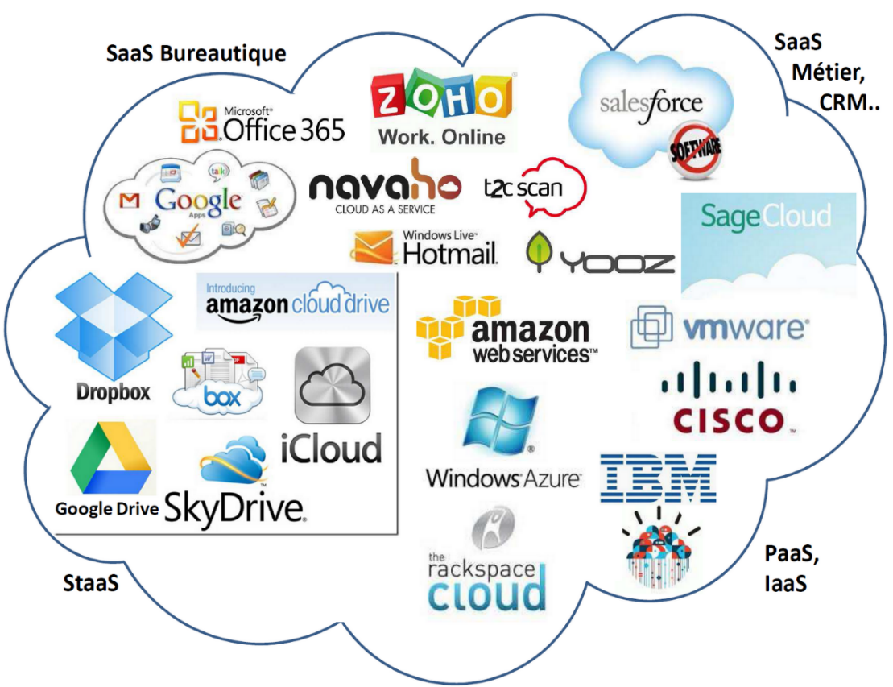
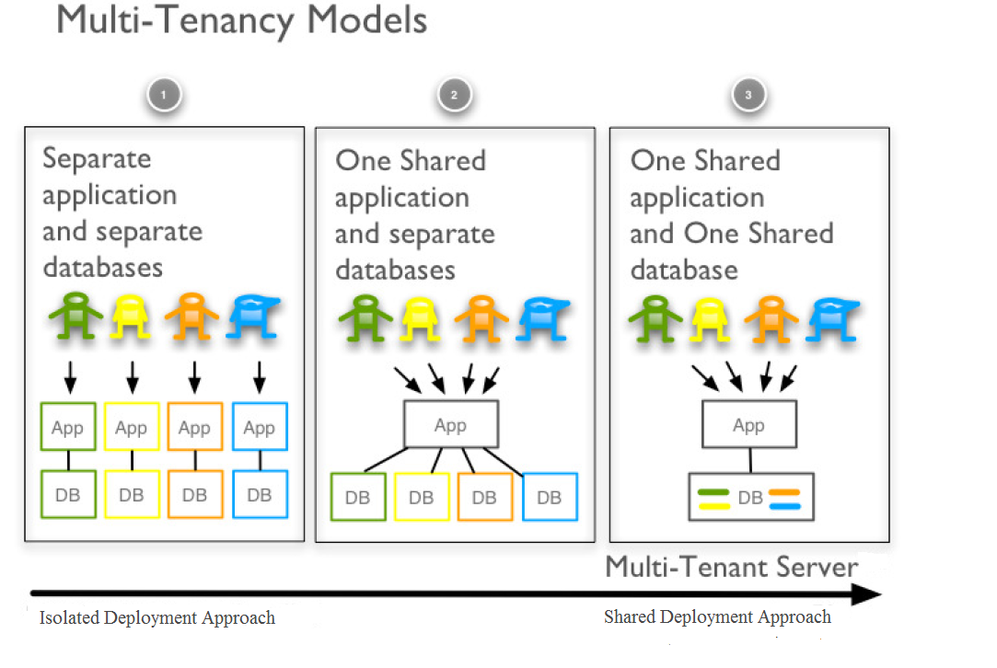
SaaS at a glance

Slide 3
configurability
We propose a fifth level of configuration. “CODE”
Tenants can develop add-on’s
Integrate them with the system.
To fulfill specific requirements without waiting for SaaS provider.
User Interface
Workflow
Data
Access Control

Slide 4

EFFECTS
Security is the major concern.
Create a novel architecture that enables CODE level extension.

